Slide 1
Visual C++
Lecture 2 – Classes and Data Abstraction II

Slide 2
Outline
Introduction
Constant Objects and Constant Member Functions
Constant Data Members
Composition: Objects as Members of Classes
friend Functions and friend Classes
Using the this Pointer
static Class Members
Data Abstraction and Information Hiding

Slide 3
Introduction
This lecture is a continuation study of classes and data abstractions with several more advanced topics.
Such topics will be about constant objects and constant members functions, friend functions and friend classes, the this pointer …

Slide 4
Constant Objects and Member Functions
Some objects need to be modifiable and some do not.
You may use the keyword const to specify that an object is not modifiable and that any attempt to modify the object should result in a compilation error.
The statement declares a const object noon for class Time and initializes it to 12 noon.
C++ does not allow member function calls for const object unless the member functions themselves are also declared const.

Slide 5
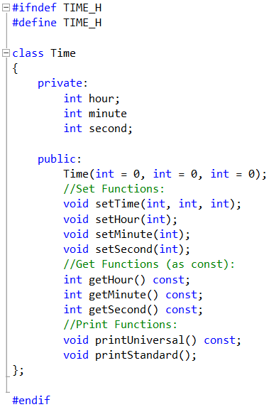
Constant Objects and Member Functions: Example
In the class Time, the constructor contains default values equal to 0 for the three integer arguments.
The Get Functions are defined as constant member functions. This means the attributes inside the class Time cannot be modified within the get functions.
Additionally, printUniversal() is also a constant member function.

Slide 6
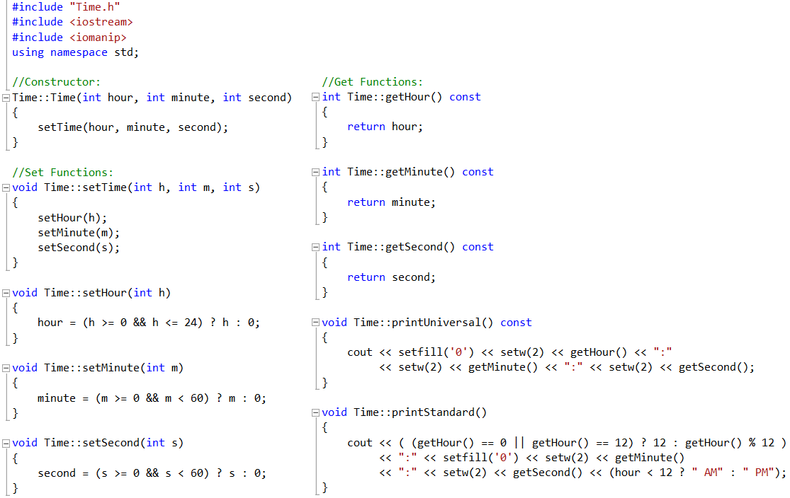
Constant Objects and Member Functions: Example

Slide 7
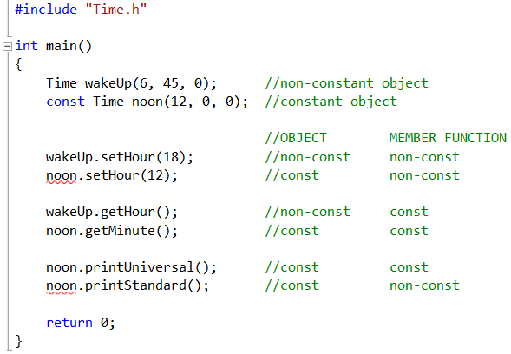
Constant Objects and Member Functions: Example
Constant objects can call constant behaviors only.
Non-constant objects can call both constant and non-constant behaviors.

Slide 8
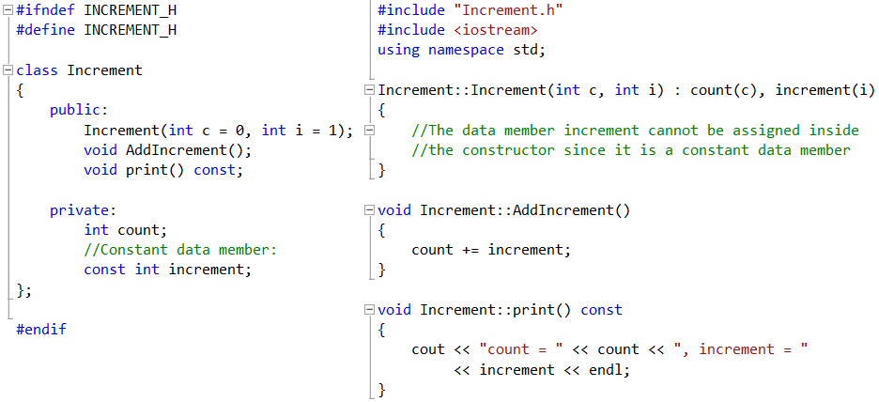
Constant Data Members

Slide 9
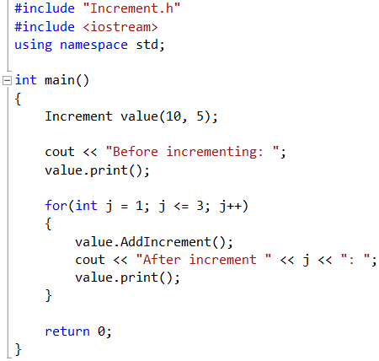
Constant Data Members
Constant data members cannot be assigned within the constructor.
Only one value can be given to constant data members.
Constant data members can be assigned through the member initializer list of the constructor.

Slide 10
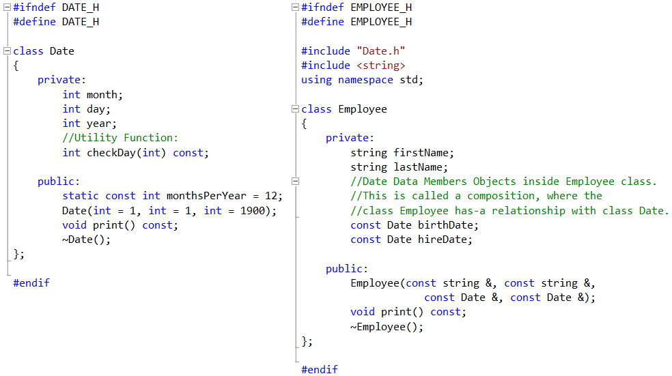
Composition: Objects as Members of Classes

Slide 11
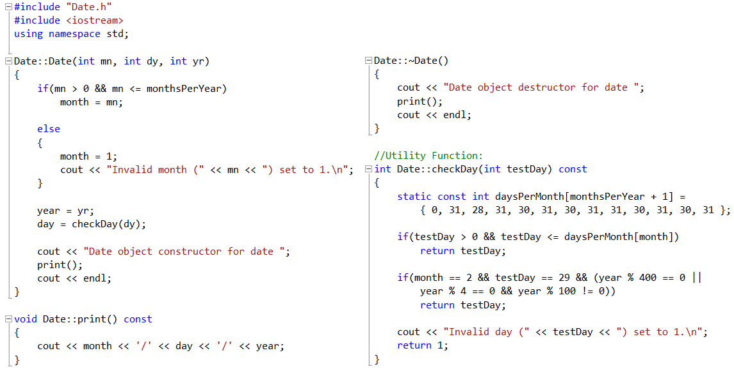
Composition: Objects as Members of Classes

Slide 12
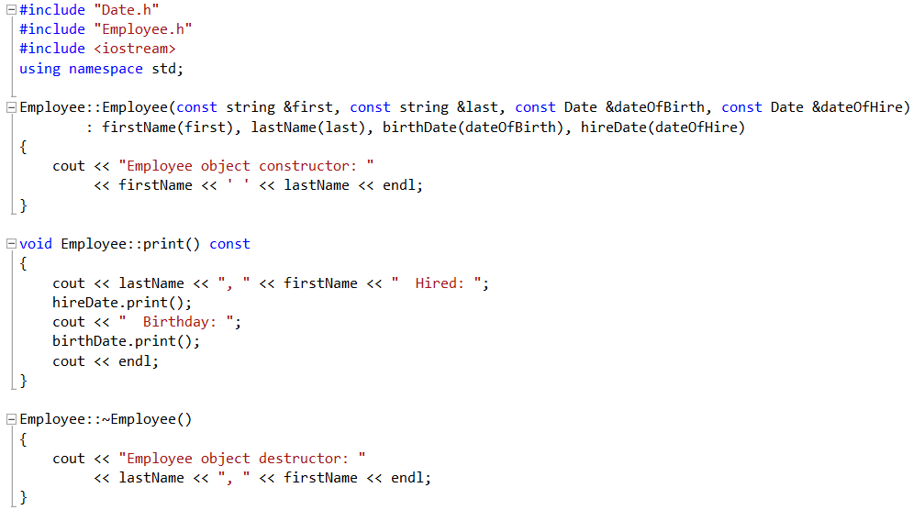
Composition: Objects as Members of Classes

Slide 13
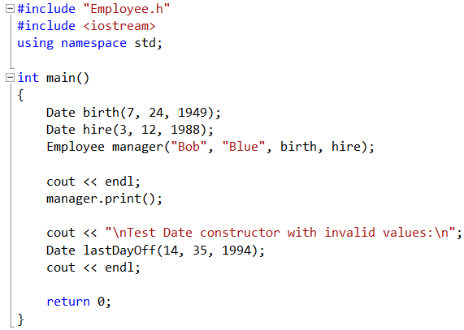
Composition: Objects as Members of Classes

Slide 14
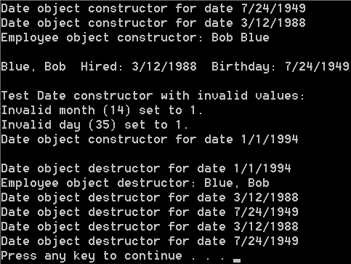
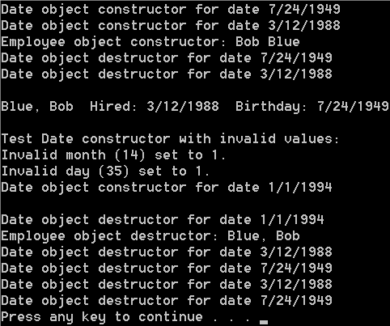
Composition: Objects as Members of Classes
Composition Objects Call-by-Reference
Composition Objects Call-by-Value

Slide 15
friend Functions and friend Classes
A friend function of a class is defined outside the class’s scope, yet has the right to access the private and public members of a class.
To declare a function as a friend of a class, precede the function prototype in the class definition with keyword friend.
To declare all member functions of class ClassTwo as friends of class ClassOne, place a declaration in the definition of class ClassOne of the form:

Slide 16
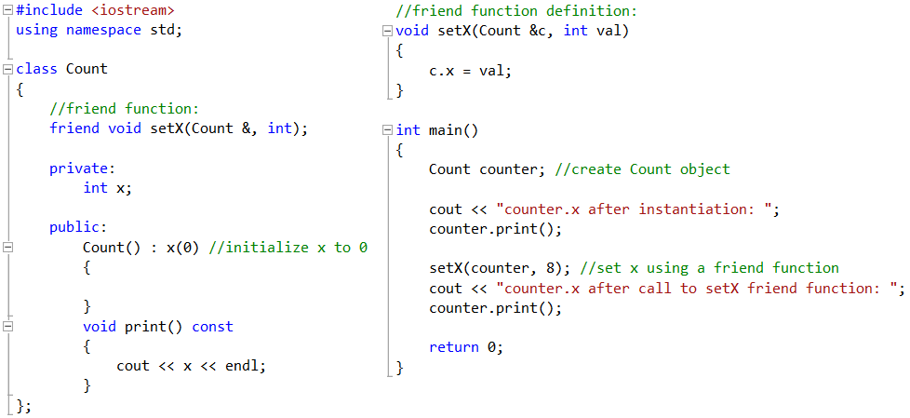
friend Functions: Example
A friend function must be defined without using the class name:: syntax. (Define it like any function written in the main file).

Slide 17
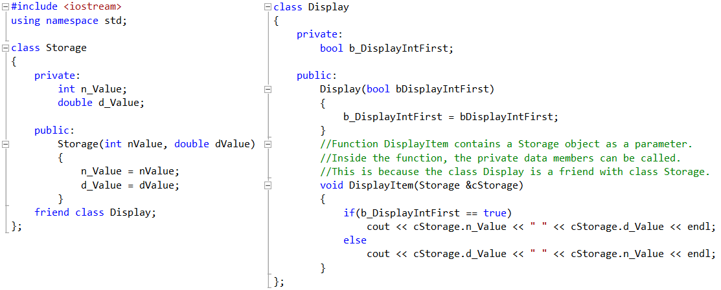
friend Classes: Example
Class Display has the ability to access the member attributes and behaviors of class Storage.
This is because class Display is a friend for class Storage.

Slide 18
Using the this Pointer
Every object has access to its own address through a pointer called this.
The this pointer is not part of the object itself.
The this pointer is passed by the compiler as an implicit (hidden) argument to each of the object’s non-static member functions.
Objects can use the this pointer implicitly (as we have done so far) or explicitly to reference their data members and member functions.

Slide 19
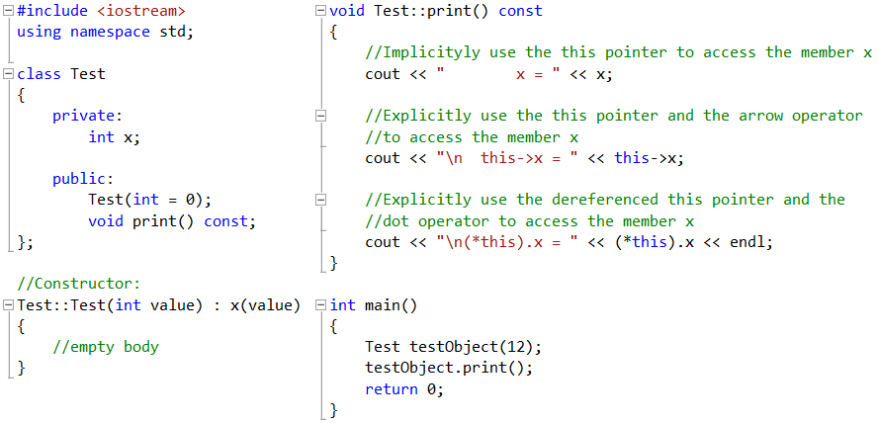
Using the this Pointer: Example

Slide 20
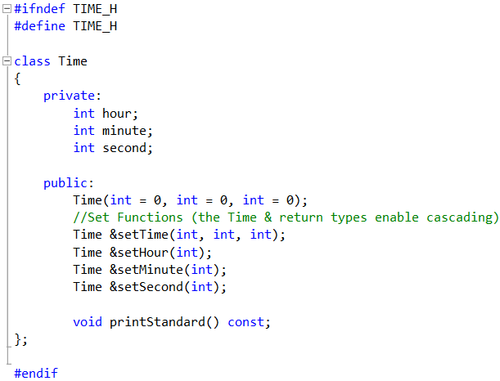
Using the this Pointer: Example 2

Slide 21
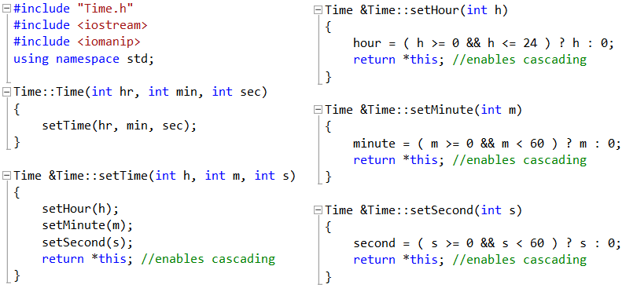
Using the this Pointer: Example 2

Slide 22
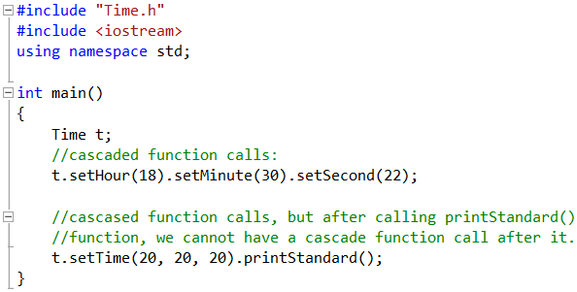
Using the this Pointer: Example 2

Slide 23
static Class Members
Each object of a class has its own copy of all the data members of the class.
In certain cases, only one copy of a variable should be shared by all objects of a class.
A static data member is used for such case.
Such a variable represents a class-wide information that is shared by all instances and is not specific to any one object of the class.

Slide 24
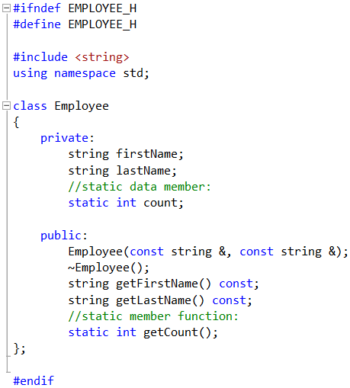
static Class Members: Example
The data member count is created as static in the private section of the class Employee.
This means the data member count will be shared by all created objects.

Slide 25
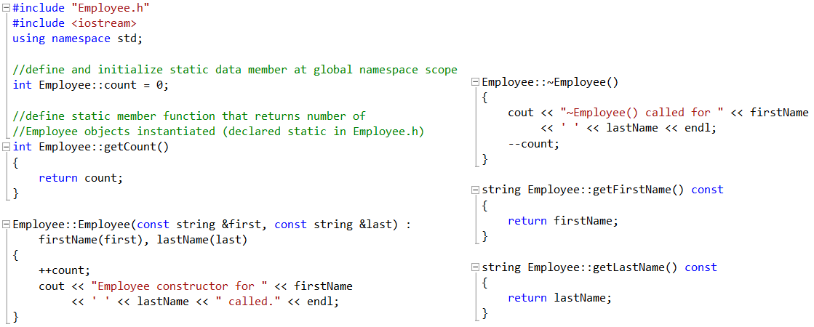
static Class Members: Example
A static member function does not have a this pointer and it cannot be defined with the keywords virtual or const.

Slide 26
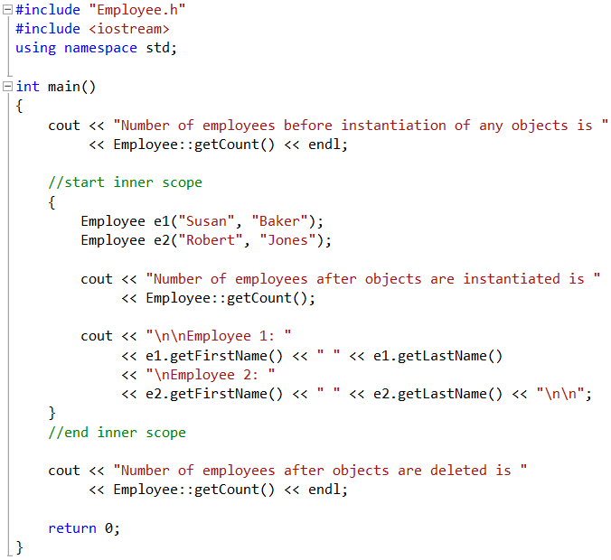
static Class Members: Example
count
Employee e1
Employee e2
You may access a static member function of the class Employee without using an object of class Employee.

Slide 27
Data Abstraction and Information Hiding
Data Abstraction:
It is about telling the user what a certain functionality does, and not about how that functionality is implemented.
The act of representing essential features without including the background details or explanations.
Information Hiding:
It is about hiding the implementation details of the classes from their clients.
This means the implementation details are hidden within the classes themselves.

